Slide 1
Project Firestone
Bringing Rock Climbing to the 21st Century
Project Firestone by Jacob Hanshaw Page 1

Slide 2
Agenda
Current Problems with Artificial Rock Walls
Project Firestone Solution
Value Added
Initial Research
Design Problems and Solutions
Future of the Project
Project Firestone by Jacob Hanshaw Page 2

Slide 3
Motivation
Colored Tape
Peels
Hard to see
Limits number of routes on a wall
Creating new routes requires blocking wall and is time consuming
Users cannot create content
Hard to point out rocks to help users
Users cannot provide feedback
Overall, a very inflexible system
Project Firestone by Jacob Hanshaw Page 3
Notes:
Must be replaced
Is impossible to see from some angles and color differentiation can be hard
Old good routes must be taken down
Making new routes with it is time consuming, requires blocking off the wall, and requires employees to attach themselves to the wall

Slide 4
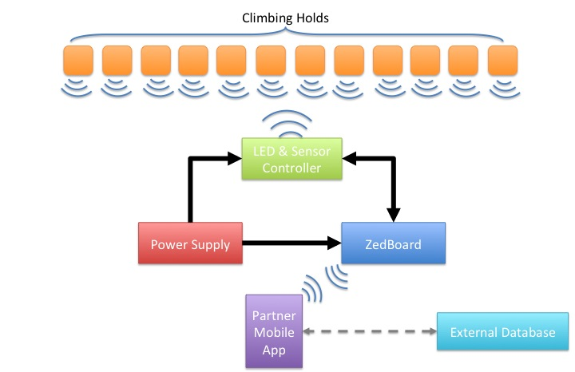
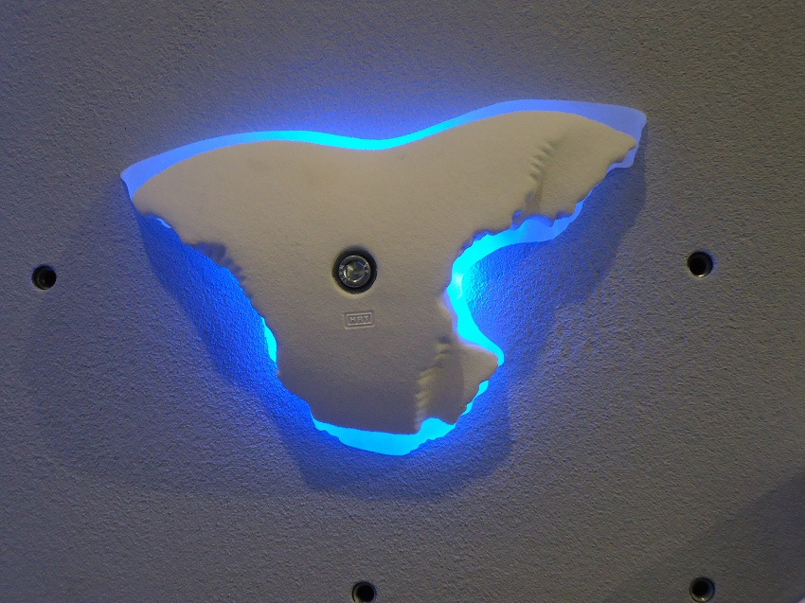
Solution
Clear holds built with multi-colored LEDs and contact sensors
Project Firestone by Jacob Hanshaw Page 4

Slide 5
Value Added
Routes are easily visible to all users
Routes are easily set and changed
Anyone can create routes
Allow custom tailored routes to the individual
Routes can easily be timed
Users can light up individual holds on the wall to discuss new routes or help others
Traditional climbing games can be automate or new games can be created
Users can view leaderboards or make routes outside of the gym
Project Firestone by Jacob Hanshaw Page 5

Slide 6
Research
Patents
Expired patent on a wired electronic system to light up holds, measure when a user touches hold, and record climbers time and progress
Patent published after start of project that uses wireless technology and a pressure sensor. Mentions using computer vision to find holds.
Competition
No existing competitor has programmable rock wall systems
A single wireless light up hold exists
Requires 4 AAA batteries and is always on
Only one shape available
Technology – need small size and low power
Wireless – Mid-Frequency radio & low power MCU
SMD LED with high brightness and low power
Camcorder battery
Piezo sensor and photo-resistor
Project Firestone by Jacob Hanshaw Page 6

Slide 7
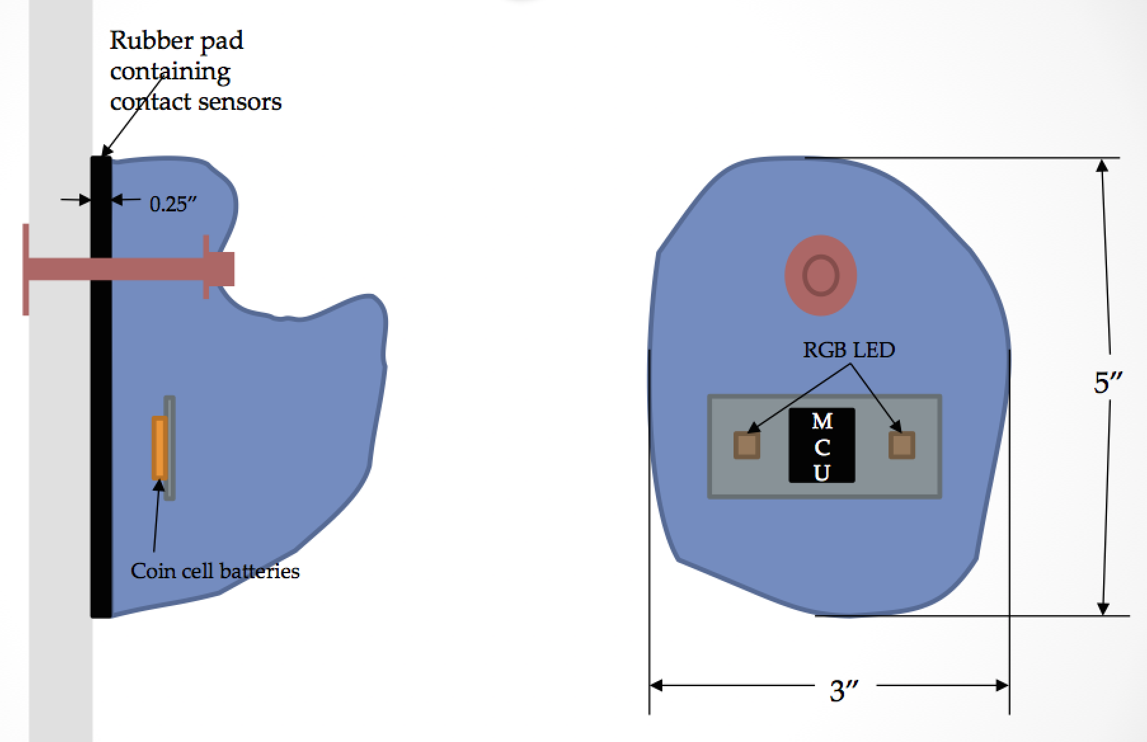
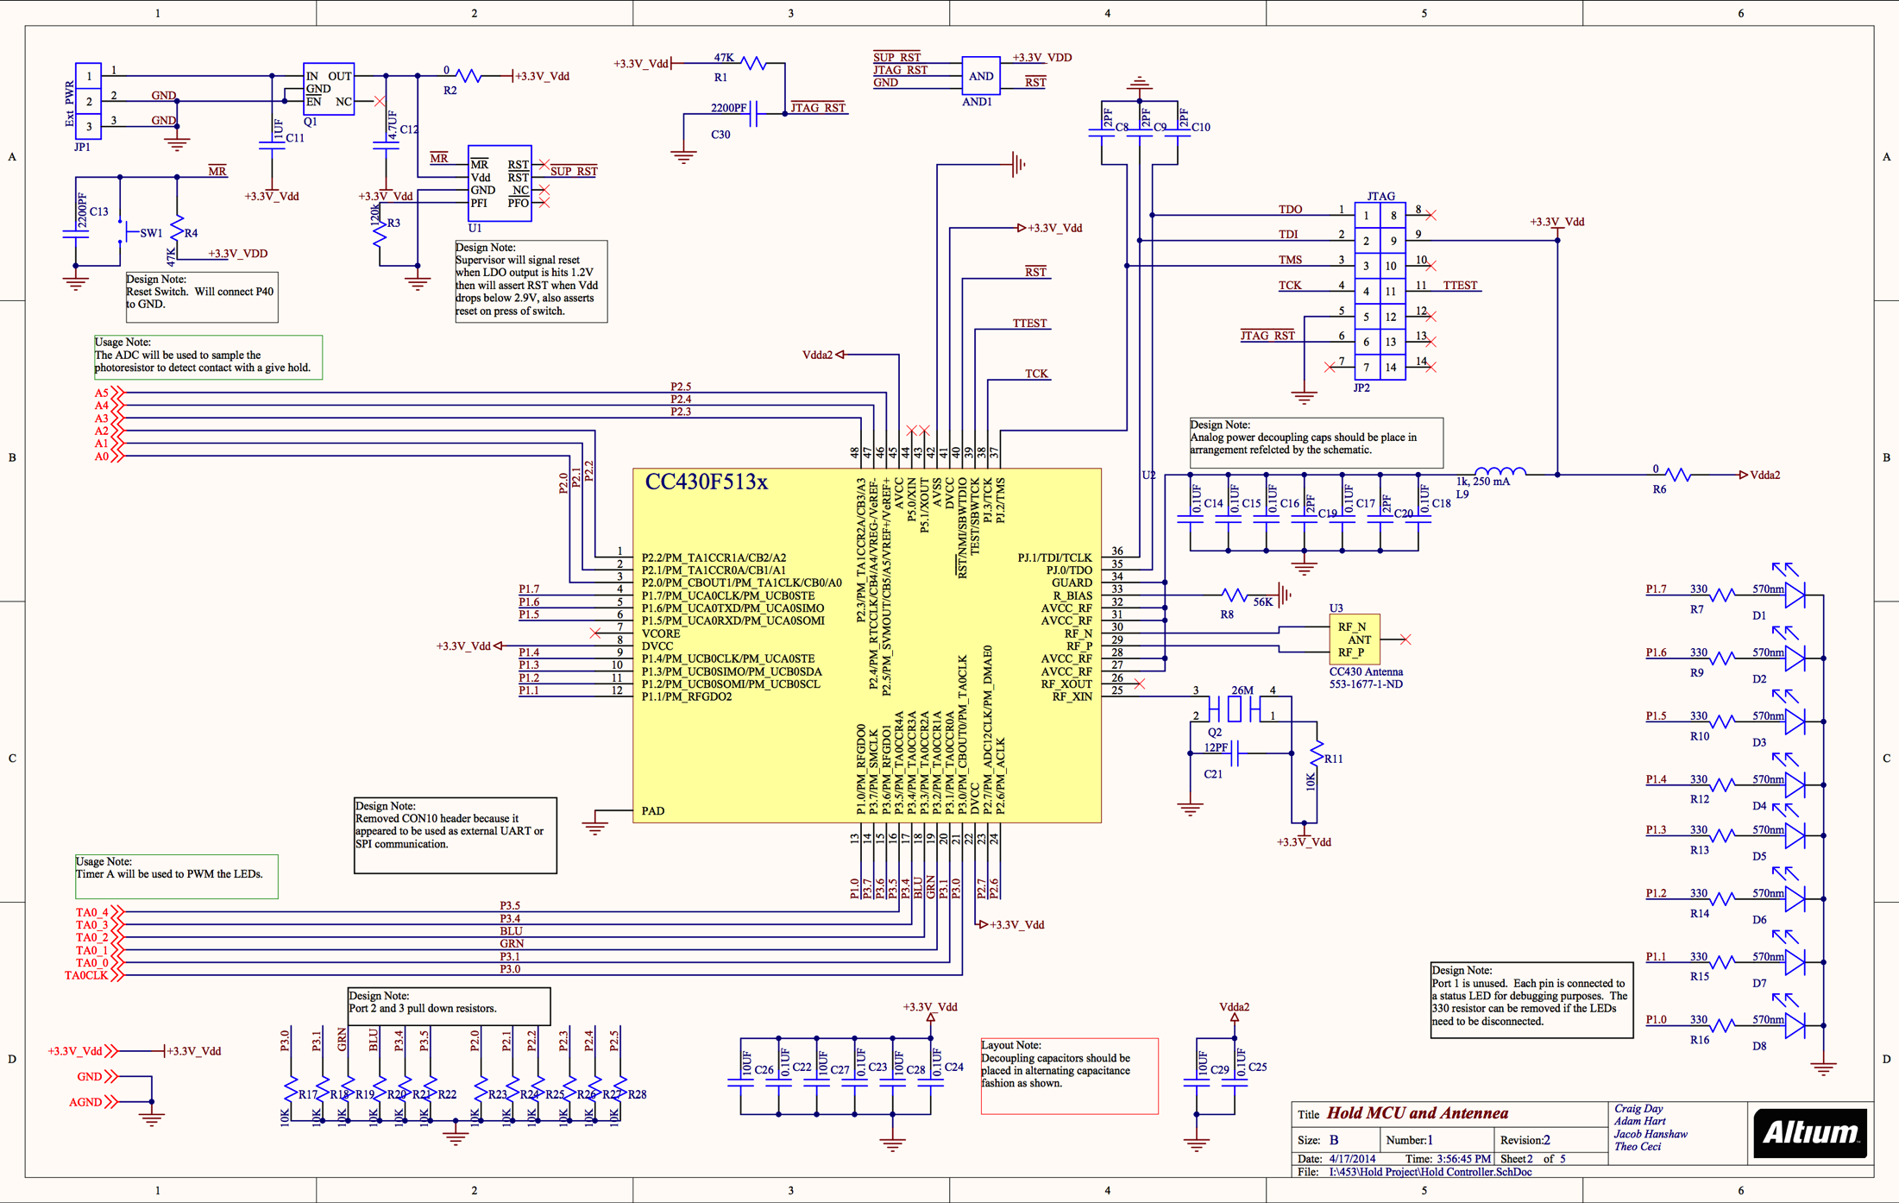
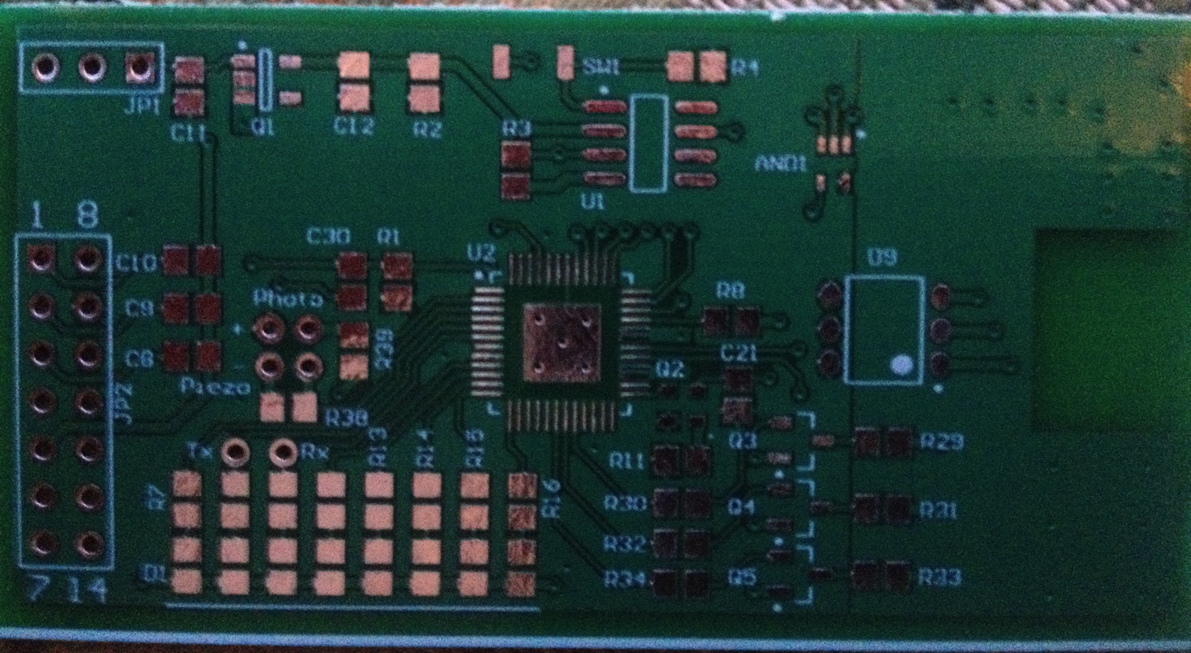
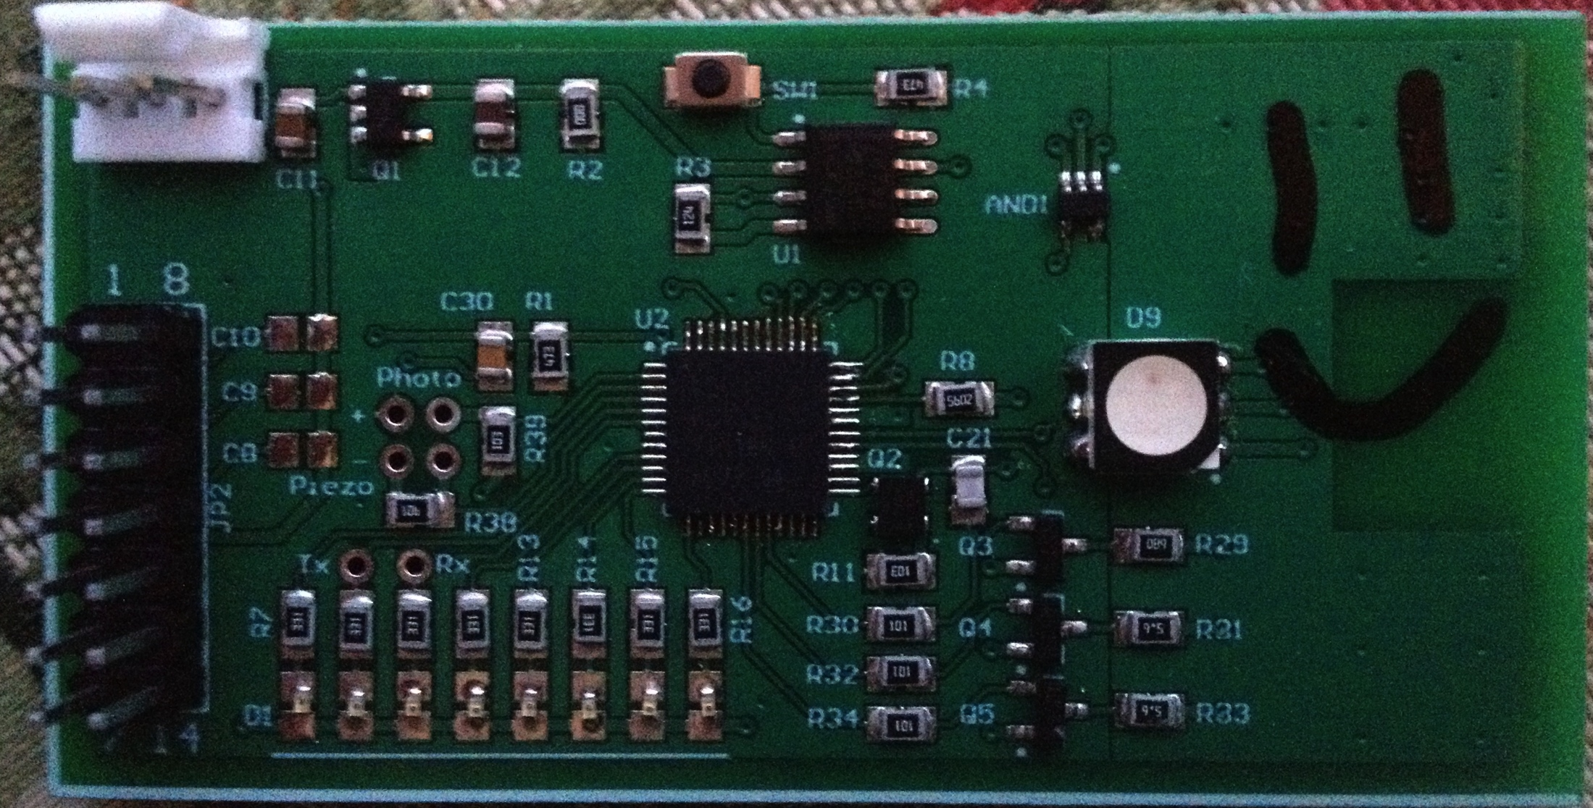
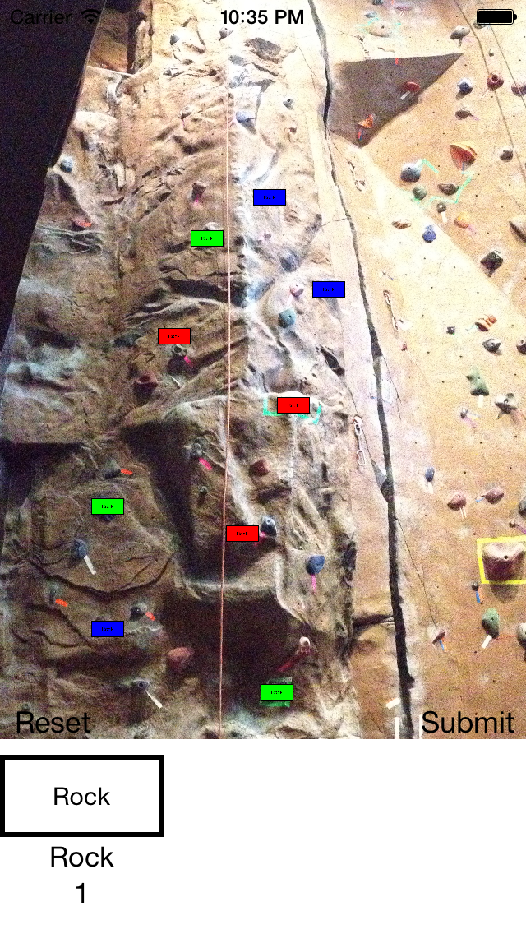
Design
Wired prototype was destroyed
Finding parts small, power efficient parts
Hardware made wrong – inverse chip layout
Reading documentation and writing software
Project Firestone by Jacob Hanshaw Page 7

Slide 8
Future
Test wireless
Write new software for hold and app
Create LLC
Contact climbing gyms
Contact patent holders
Create smaller board layout
Find more efficient parts
Project Firestone by Jacob Hanshaw Page 8

Slide 9
Resources
Hold molding information:
http://www.instructables.com/id/LED-Climbing-Holds/
Business information:
http://finance.yahoo.com/blogs/power-pitch/turning-rock-climbing-hobby-millions-125132801.html
http://www.azcentral.com/business/articles/20120802tempe-rock-climbing-holds-maker-hobby-livelihood.html
Patents:
https://www.google.com/patents/US5732954?dq=LED+rock+climbing+hold&hl=en&sa=X&ei=RfA6U_DULqqqyAGwpoGAAg&ved=0CGwQ6AEwBw
https://www.google.com/patents/US8668626?dq=rock+climbing+hold+wireless&hl=en&sa=X&ei=7f85U_2hHKTr2QWq4IGoBw&ved=0CEcQ6AEwAg
Datasheet:
http://www.ti.com/lit/ug/slau278q/slau278q.pdf
Light-up hold photo:
http://seanmccoll.com/2013/03/new-hrt-systems/
Project Firestone by Jacob Hanshaw Page 9

